Slide 1

SKD072511-18 D40RWB241-F-T2
MANTA SOP

Slide 2

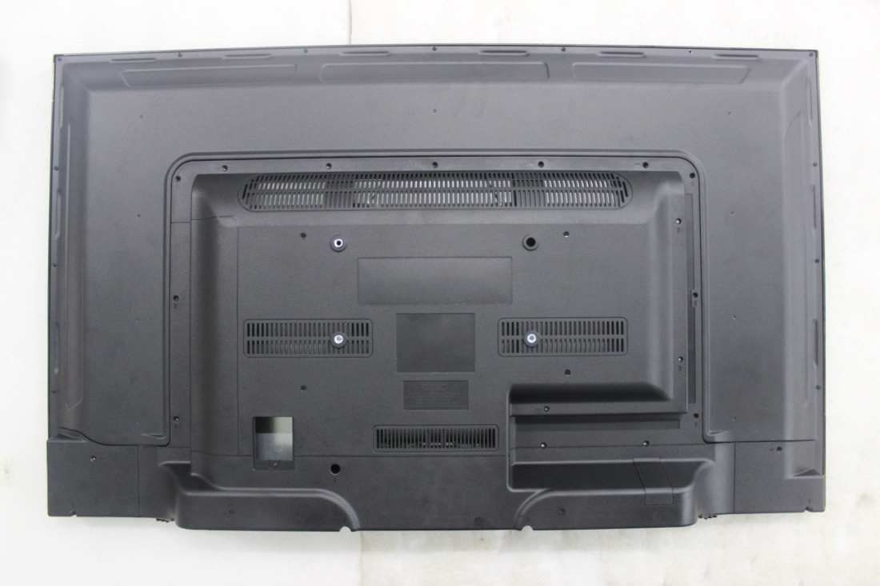
1. Remove back cover screw/remove back cover
ATTENTION：1. The torque of the electric batch is 3.5 + / 0.5Kgf/cm2;You can't touch the COF.
Remove 16 PCS KM3*6 black screws
(circle)
Remove 6 pcs PA3*10 black screws

Slide 3
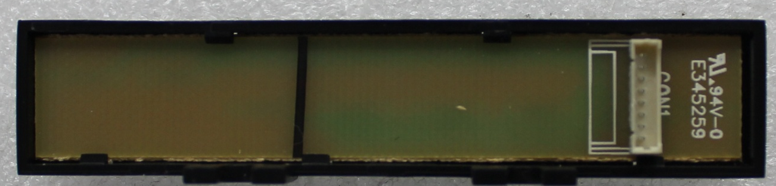
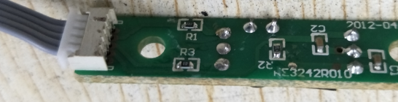
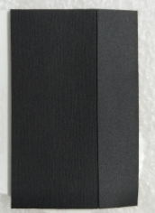
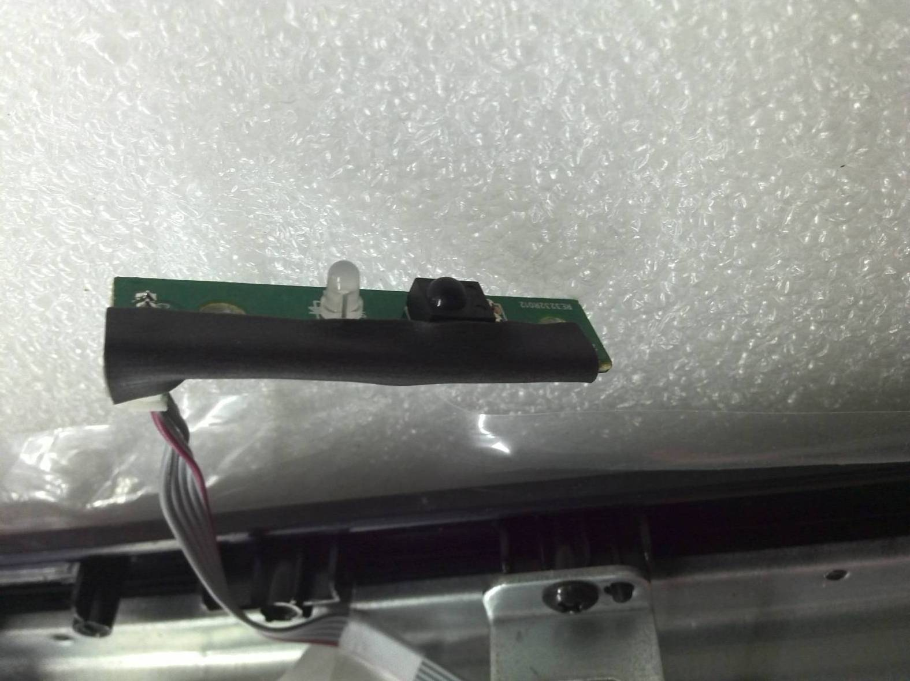
2.keyboard、IR board process
attention：1. Anti-static;2,IR board wire should be inserted in place；3. The button of the function bracket shall not be tilted or broken ；
Function button holder
(P/N : AR0110096)
The button position shall be stuck in place, and the PCB board shall be mounted on the button holder buckle
Keyboard suit(P/N :AT0080258)
Insert IR board connect cabel(P/N::AE0041688
IR board suit(P/N :AT0090272)
Paste form on IR board（ P/N ： AS0030658 ），Align the cotton foam left side with the remote control board socket end edge
form(P/N :AS0030658)

Slide 4
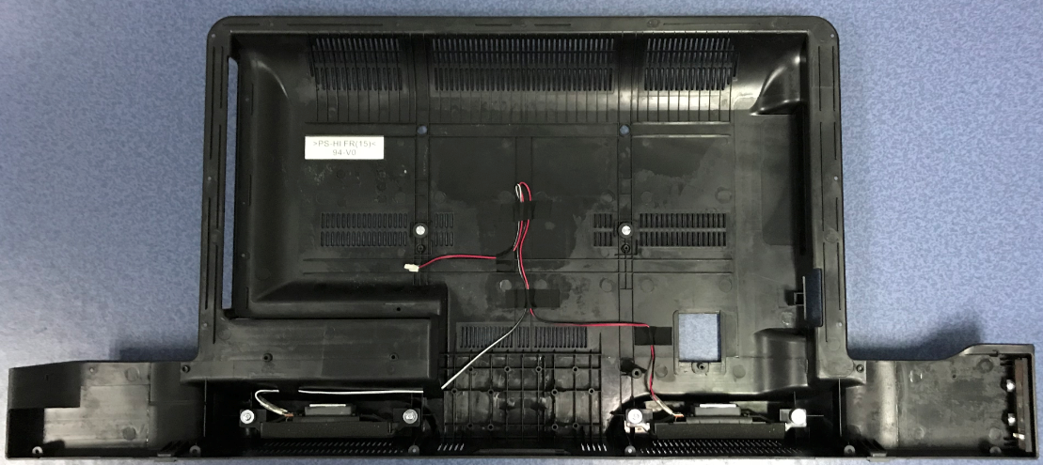
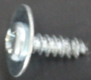
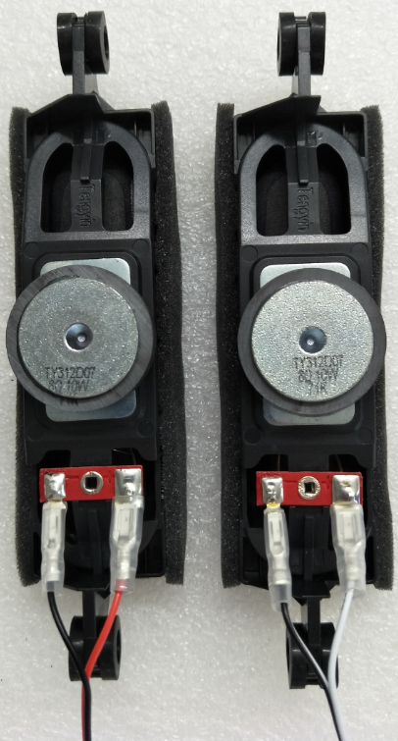
3. Lock speaker
Attention ：1. The torque of the electric batch is 4.0 + / - 0.2Kgf/cm2
；
PWA4*13 white screw(P/N :AS0010108)
Back cabinet(P/N :AR0020810)
The white line is on the left
The red line is on the right
Processed speaker
Screw 4 pcsPWA4*13
White screw

Slide 5
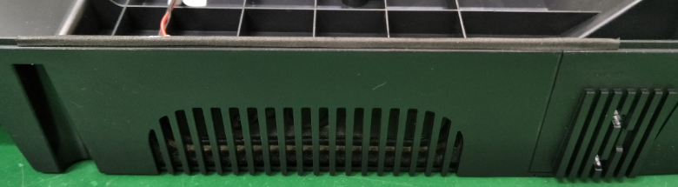
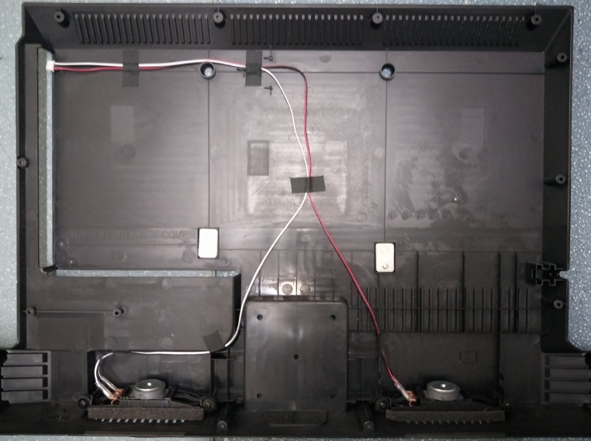
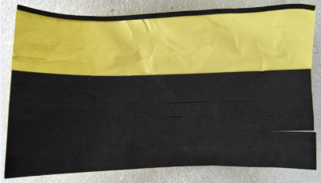
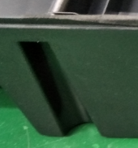
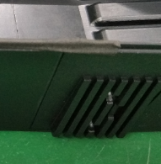
4.Paste EVA pad
attention： 1.EVA pad Must be attached;；
EVA PAD(P/N :AS0030762)
OK
NG
NG
Stick 2 pcs 125*10*0.5mm EVA pad

Slide 6
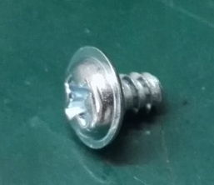
5.Lock keyboard bracket
attention：1. The torque of the electric batch was 2.7 + / - 0.2Kgf/cm2.
Lock PWB3*6
White screw
Install the function key bracket
PWB3*6 screw （ P/N :AS0010115）

Slide 7
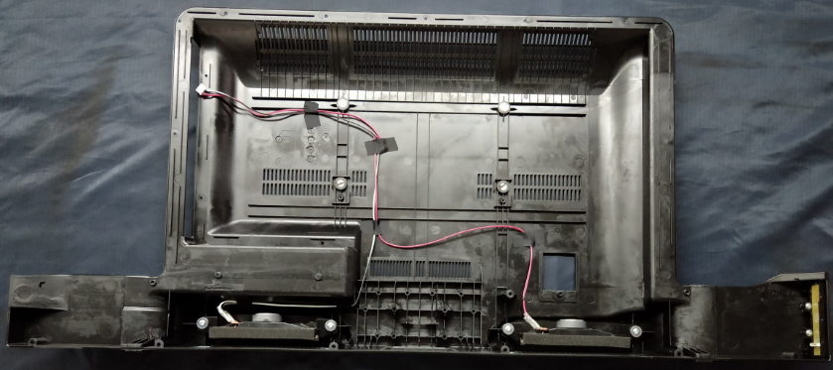
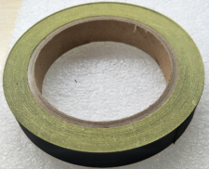
6. arrange the line on back cabinet
Attention ：1. Acetate tape should be attached tightly
Align the horn terminal with the inner edge of the rear cover
6 sections of 40mm adhesive tape are pasted in the red square
Acetate tape 40MM
(P/N :AF0030368)

Slide 8
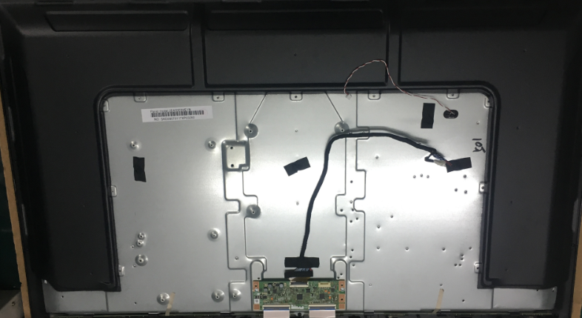
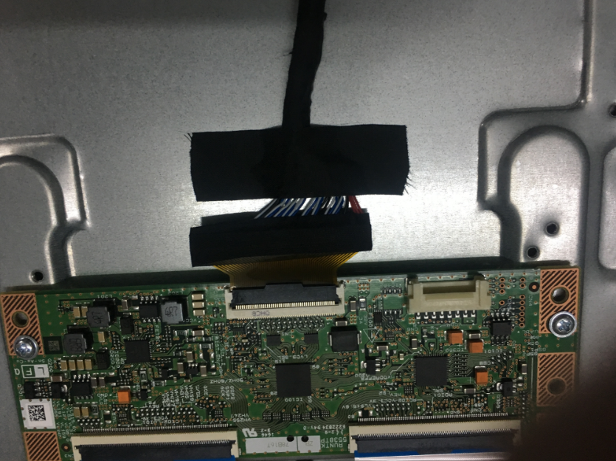
7.Insert pancel cable
Attention ： 1. Anti-static;You can't touch the COF.3. The screen line shall be inserted in parallel;4. Button the screen thread tightly ；
Tear off the tape that holds the tube's extension cord
Stick 1 pcs60MM Acetate tape(P/N : AF0031369)
Insert panel cable(P/N : AE0042482)

Slide 9
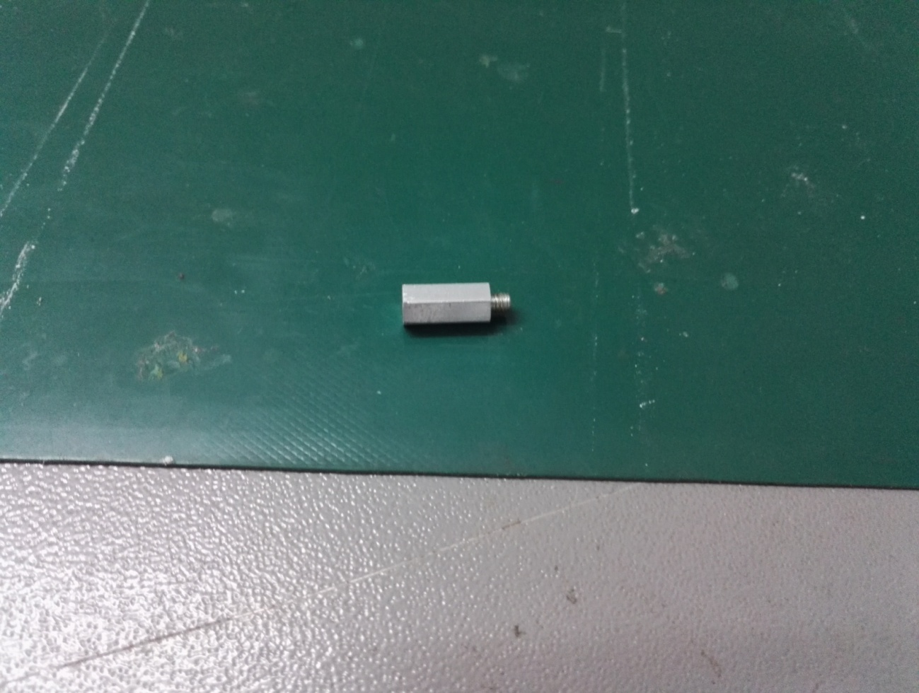
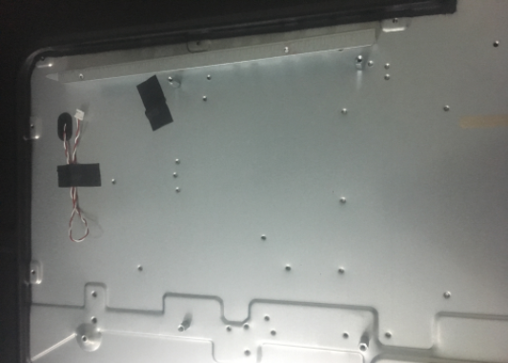
8. Lock hexagonal bolt/ and terminal board-side
Attention ：1. The torque of the electric batch is 3.5 + / 0.5Kgf/cm2. can't touch the COF ；
Put terminal board(P/N : AW0041847)
Hexagonal bolt
M3*4(P/N : AS0020065)
摆放侧端子板(料号: AW0041847)
Hexagonal bolt
M3*6(P/N : AS0020034)
锁两颗六角螺丝柱M3*6 (料号: AS0020034)
Lock 2 cps Hexagonal bolt
M3*6 (P/N : AS0020034)
锁两颗六角螺丝柱M3*4(料号: AS0020065)
Lock 2 cps Hexagonal bolt
M3*4(P/N : AS0020065)

Slide 10
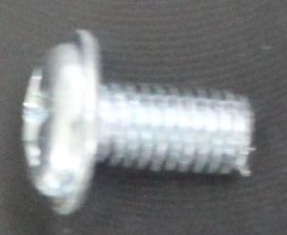
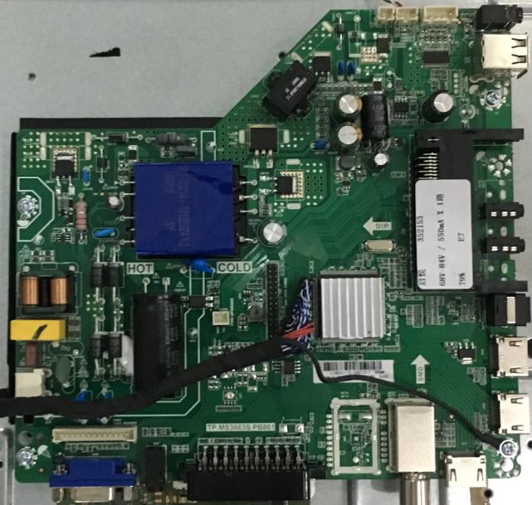
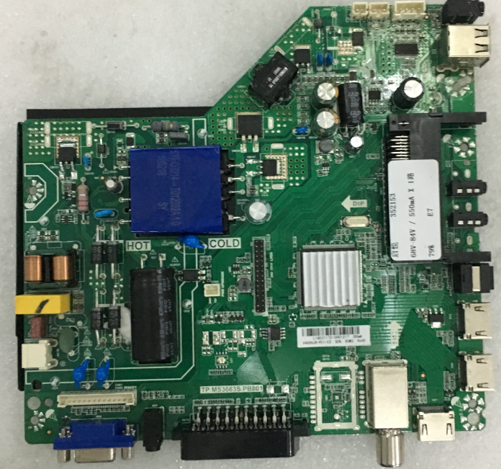
9.Lock mainboard
attention：1. Anti-static;2. The torque of the electric batch is 3.5 + / 0.5Kgf/cm2;You can't touch the COF.
PWM3*6 screw(P/N : AS0010433)
3
2
Lock 4 pcs PWM3*4 white screw
4
mainboard (P/N : AE0011469)
Fix the floor and pull up 45 degrees
1

Slide 11

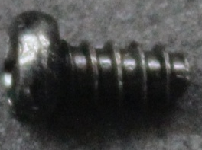
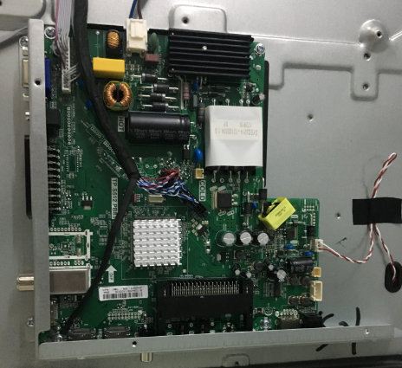
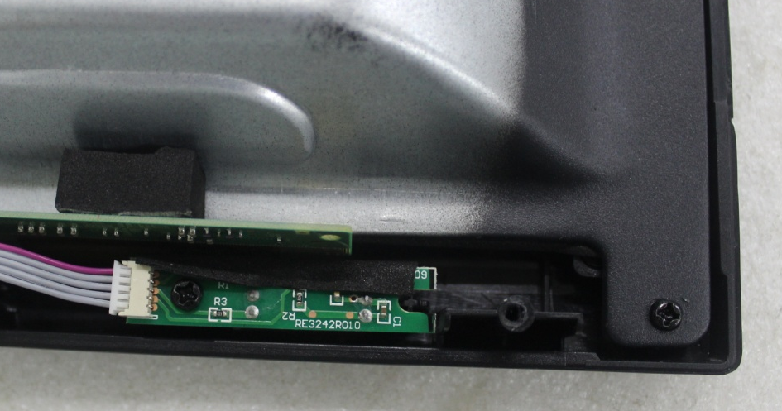
10.Lock IR board /terminal board
attention： 1. Anti-static;2. The torque of the electric batch is 3.0 + / 0.5Kgf/cm2;You can't touch the COF ；
PWM3*4 white screw(P/N : AS0010430)
PA3*6 black screw(AS0010261 )
Install side terminal board(P/N : AW0041847)
lock 2 pcs PWM3*4 white screw
Install IR board suit
install(P/N : AW0041848)
1
2
Lock 1 pcsPA3*6 black scre
3
Lock 2pcs PWM3*4white screw

Slide 12
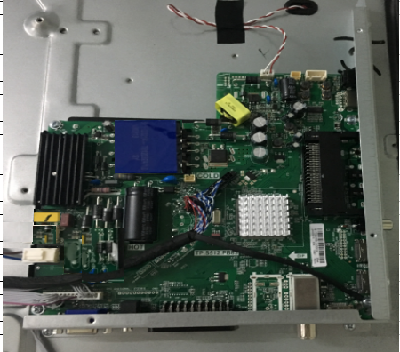
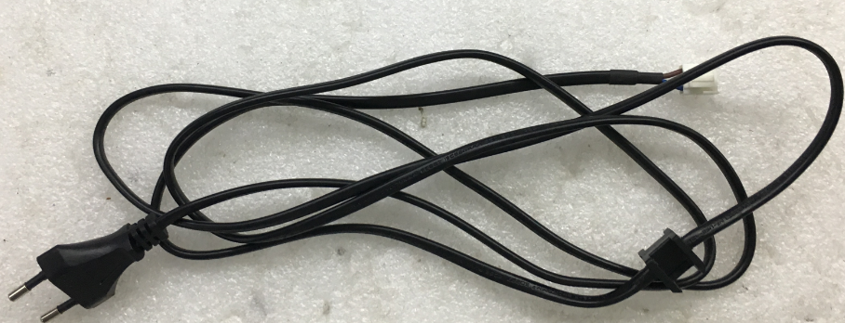
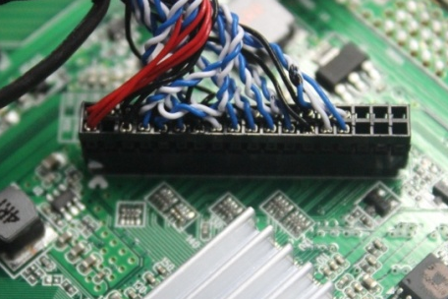
11.Insert cable
Attention ：1. Anti-static;2. All wires shall be inserted in place;You can't touch the COF.
Insert the extension cord of the lamp
Power cable P/N : （AE0041892)
The white dots on the screen end align with the "triangle" symbol of the motherboard
Insert power cable
Insert panel cable
Insert key board wire + IR board wire

Slide 13
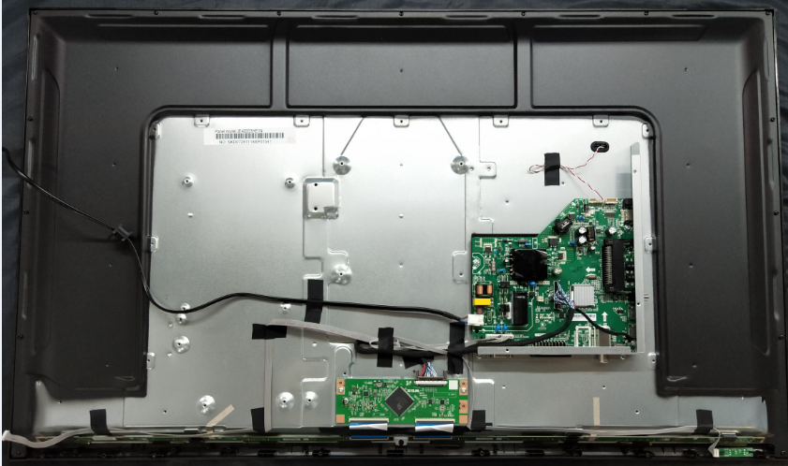
12.Arrange cable
Attention ：1. Anti-static;2. Wire rod avoids the high pressure part;3. can't touch the COF.
60MM Acetate tape(P/N :AF0030369)
所有线材要避开高压部分6mm以上
40MM Acetate tape(P/N :AF0030368)
蓝色框处贴3段60mm醋酸胶布
红色框处贴6段40mm醋酸胶布
所有线材要避开此螺丝孔
按键板线端子与面壳边缘对齐

Slide 14
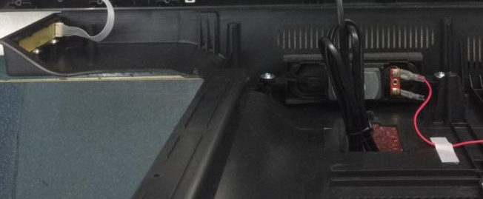
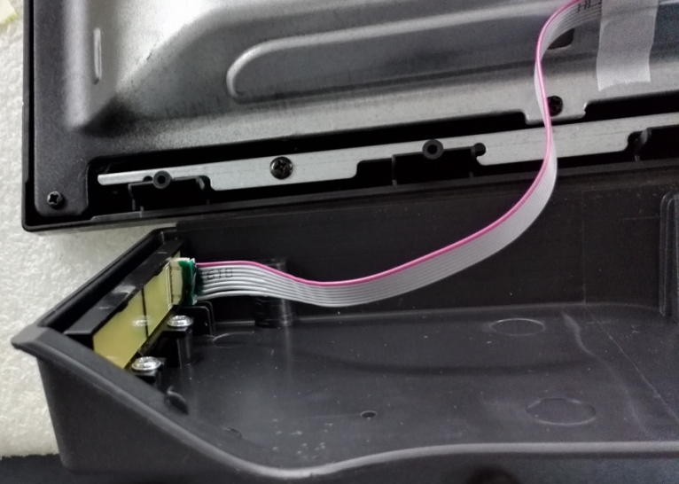
13. Insert keyboard cable
Attention ：1. Electrostatic discharge;You can't touch the COF.3. The connection line should be inserted tightly;
The power cord passes through the rear cover hole from the outside to the outside
(P/N : AE0041892)
Insert keyboard cable

Slide 15
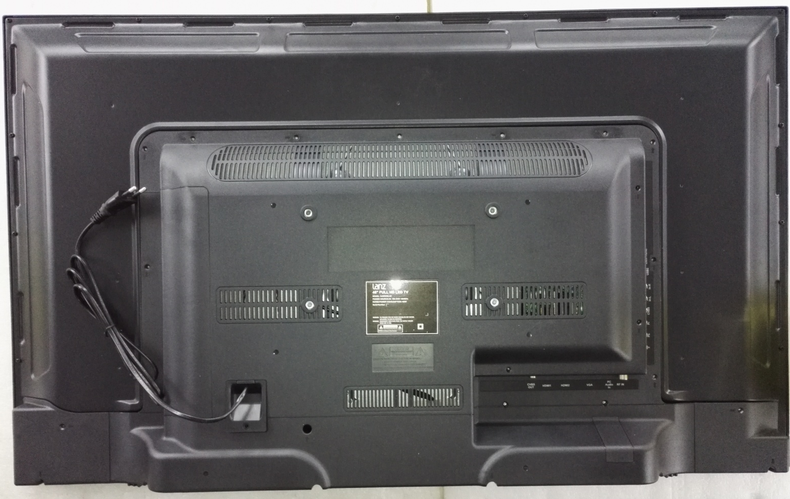
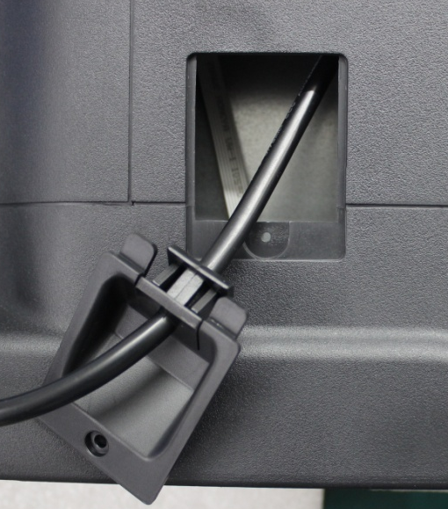
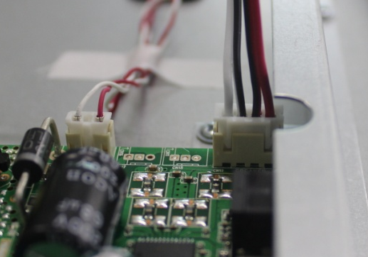
14.insert speaker cable,and put the back cabinet
Attention ： 1. Anti-static;You can't touch the COF.3. The rear cover shall be in place ；
put Clamp plate(P/N :AR0150003)
Insert speaker cable
Put back cabinet

Slide 16
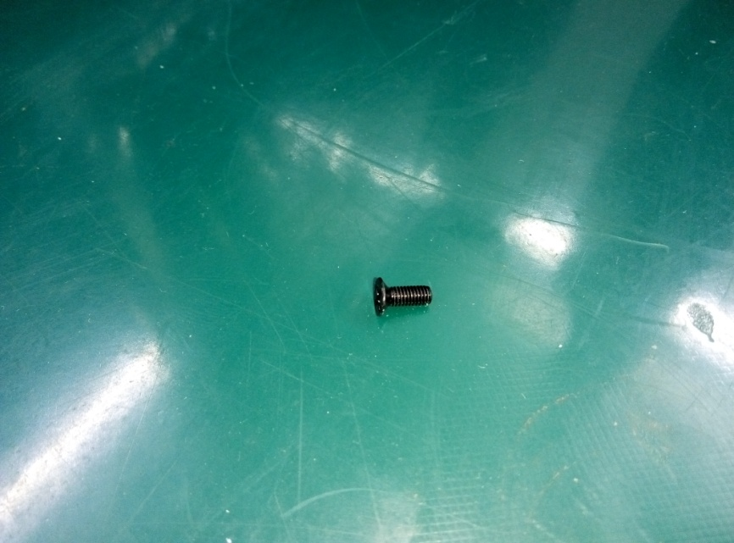
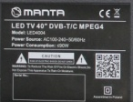
15.ScreW back cabinetI
attention： 1. The terminal board screw shall be locked first;2. The torque of the electric batch is 3.5 + / 0.5Kgf/cm2 ；
KM3*6 black screw (P/N :AS0010409)
Screw19 pcs KM3*6black screw(P/N :AS0010409)

Slide 17


16.Screw back cabinet II
attention： 1. 1. The terminal board screw shall be locked first;2. The torque of the electric batch is 3.5 + / 0.5Kgf/cm2 ；
PA3*10 black screw (P/N :AS0010262)
Screw 1pcsTA3*8 black screw (P/N :AS0010134)
TA3*8 black screw (P/N : AS0010134)
Screw 6pcsPA3*10 black screw (P/N :AS0010262)

Slide 18

Thank!

